Slide 1
BLM2041 Signals and Systems
Syllabus
The Instructors:
Doç. Dr. Ali Can Karaca
ackaraca@yildiz.edu.tr
Dr. Ahmet Elbir
aelbir@yildiz.edu.tr

Slide 2
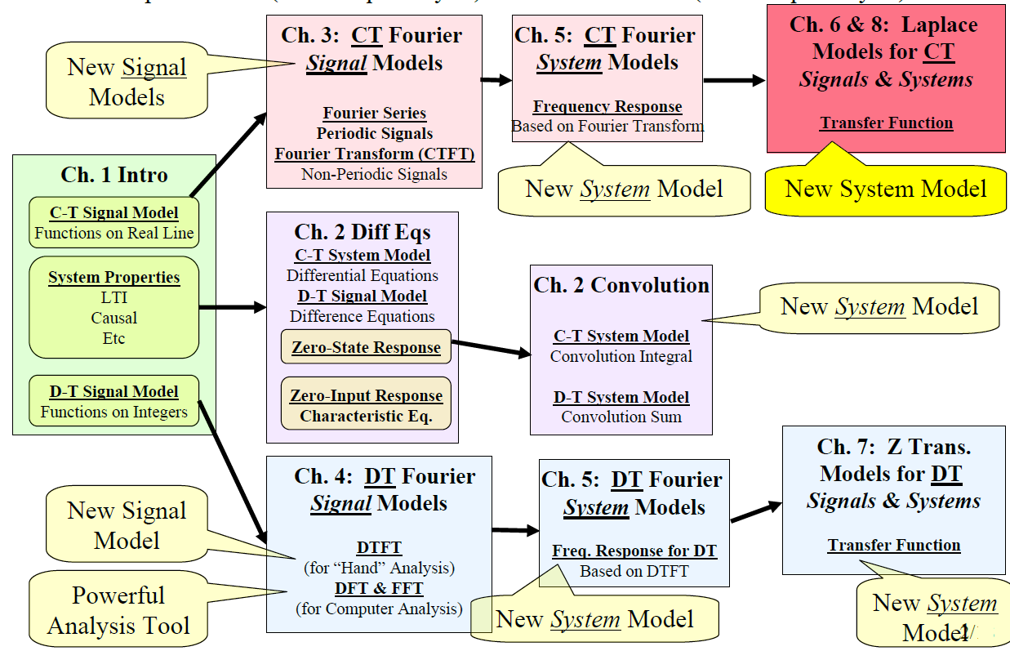
Where are we now?

Slide 3
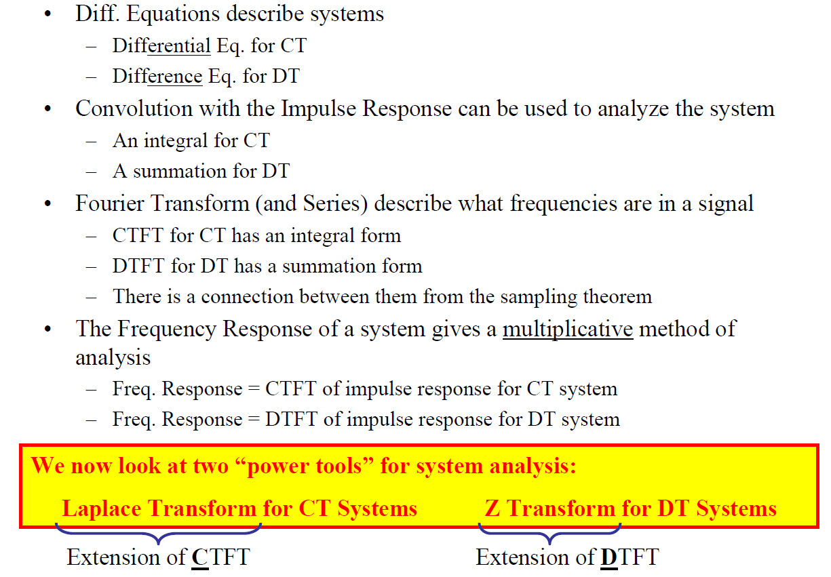


What we have seen so far….
one

Slide 4
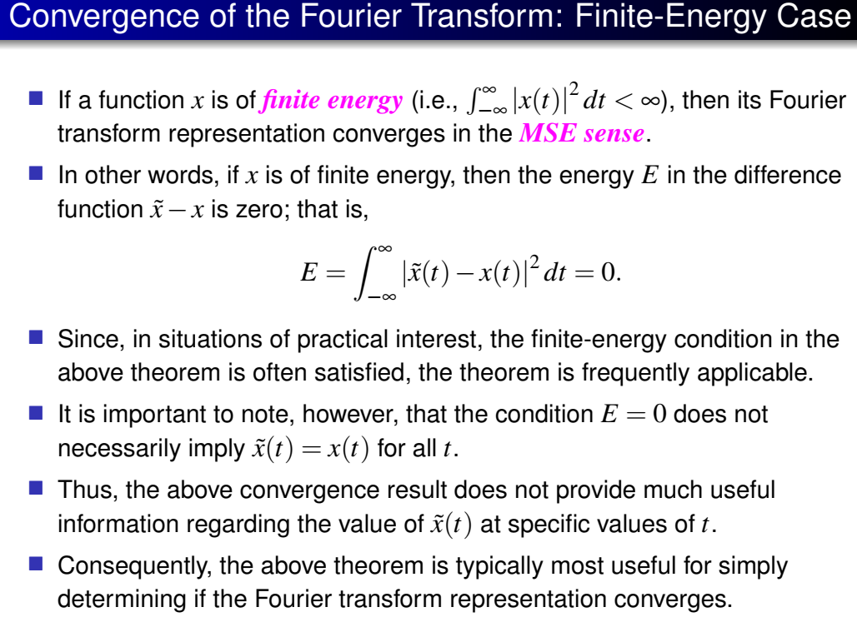
What we have seen so far….

Slide 5
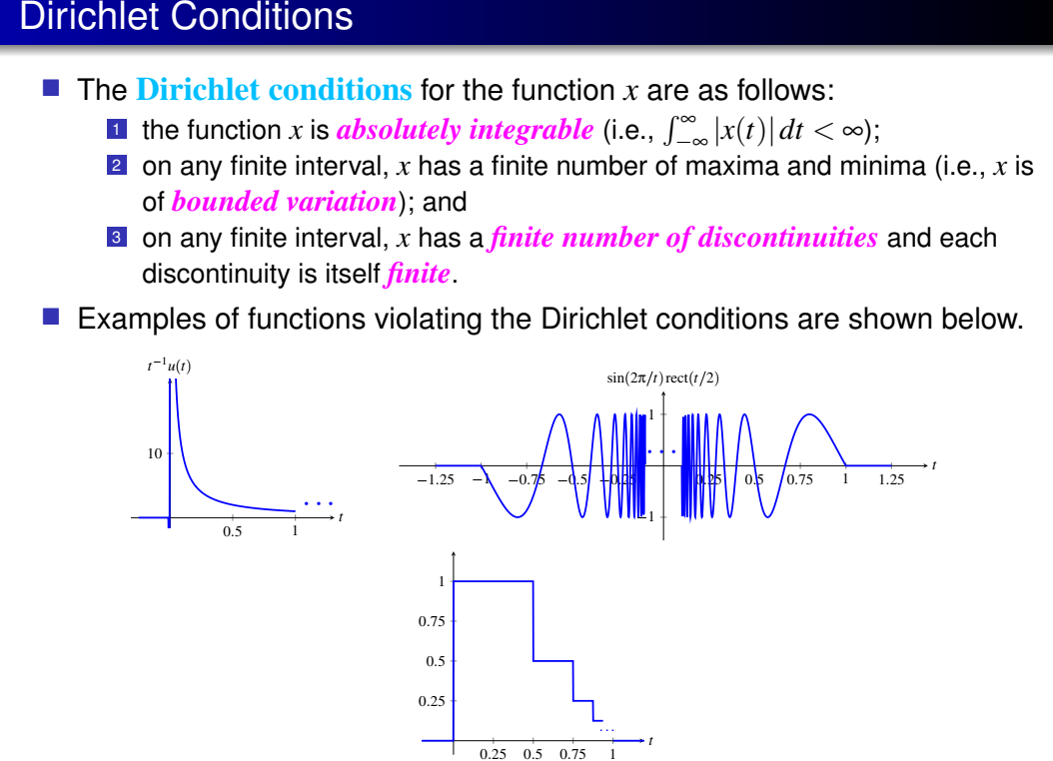

Slide 6
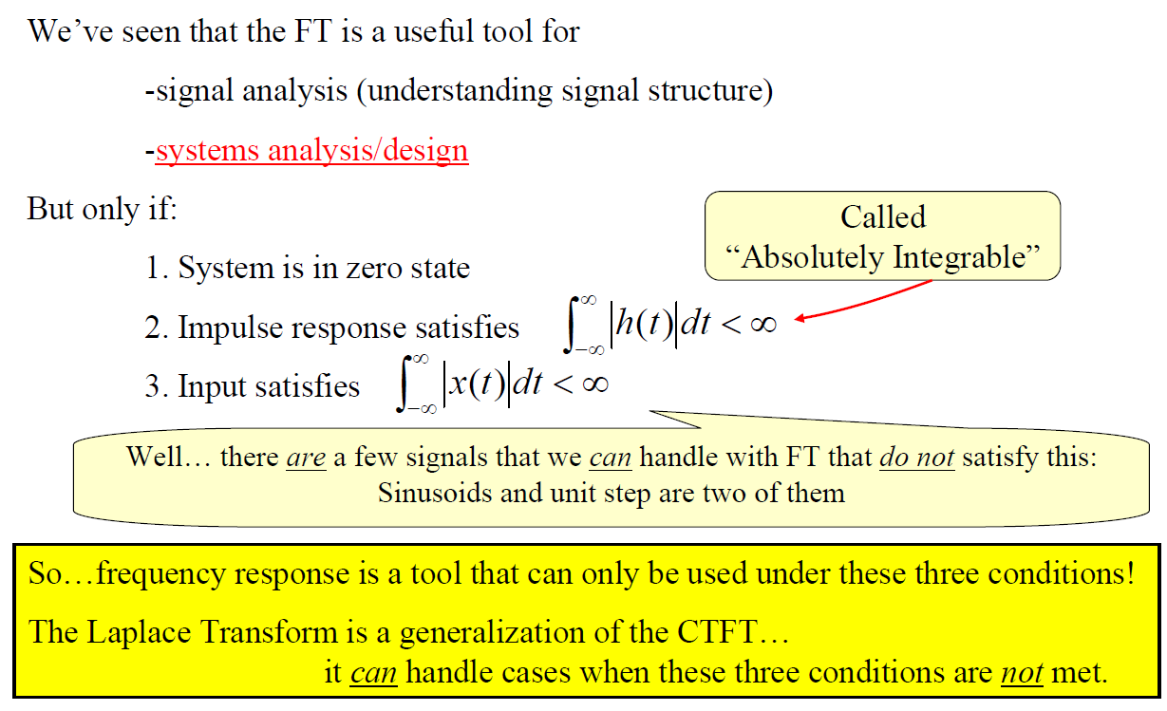
Laplace Transform

Slide 7
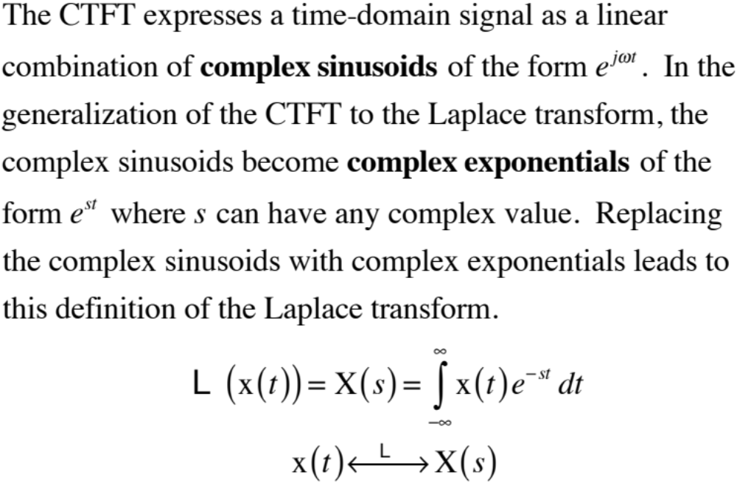
Generalizing the Fourier Transform
M. J. Roberts - All Rights Reserved. Edited by Dr. Robert Akl

Slide 8
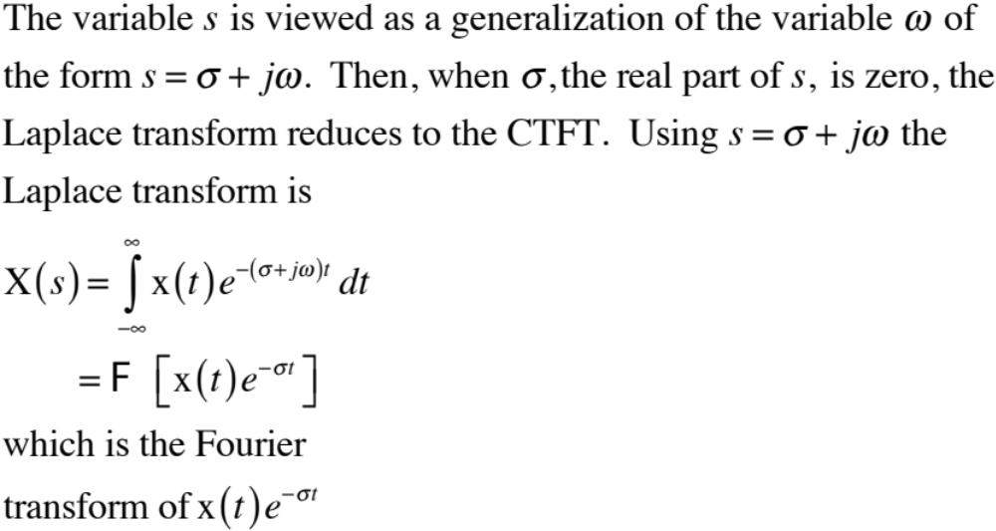
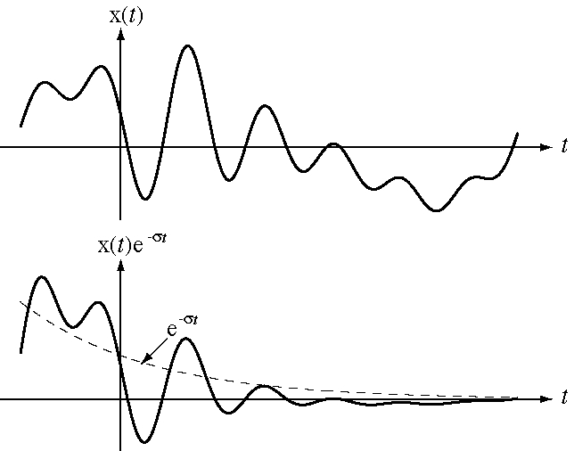
Generalizing the Fourier Transform
M. J. Roberts - All Rights Reserved. Edited by Dr. Robert Akl

Slide 9
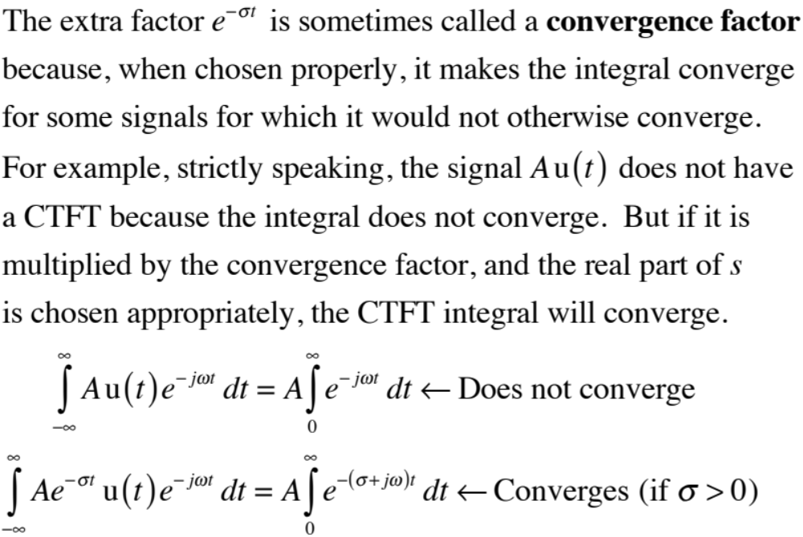
Generalizing the Fourier Transform
M. J. Roberts - All Rights Reserved. Edited by Dr. Robert Akl

Slide 10
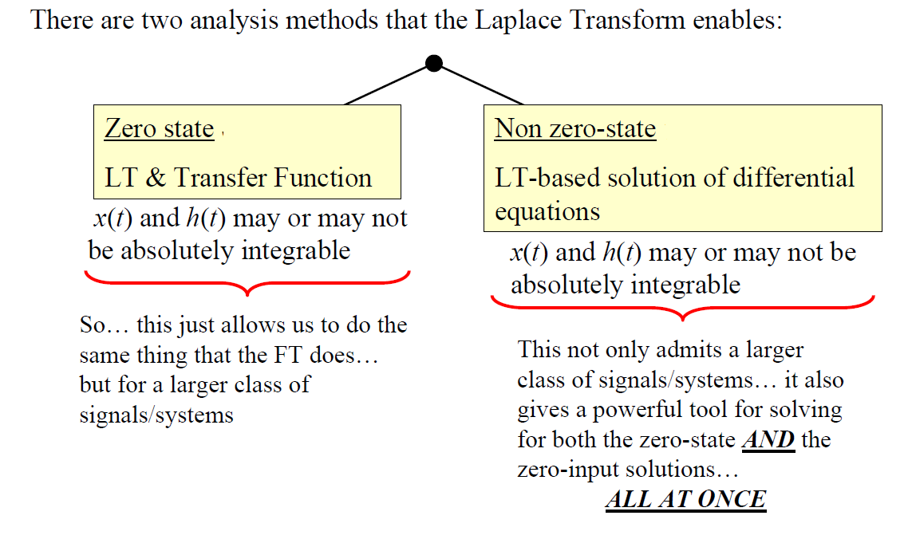
Laplace Transform

Slide 11
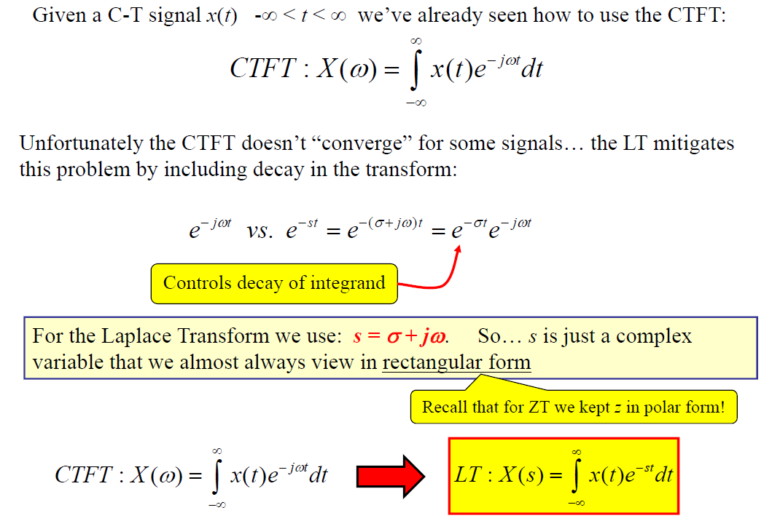

Laplace Transform Definition

Slide 12
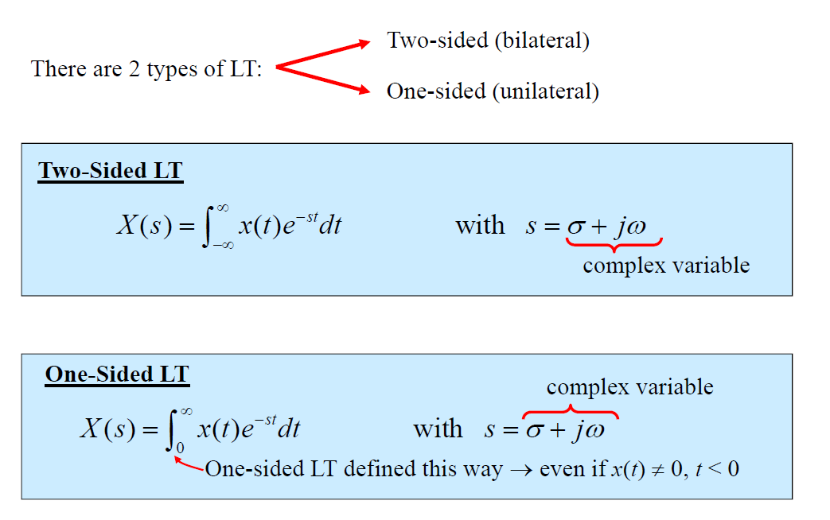
Laplace Transform Definition

Slide 13
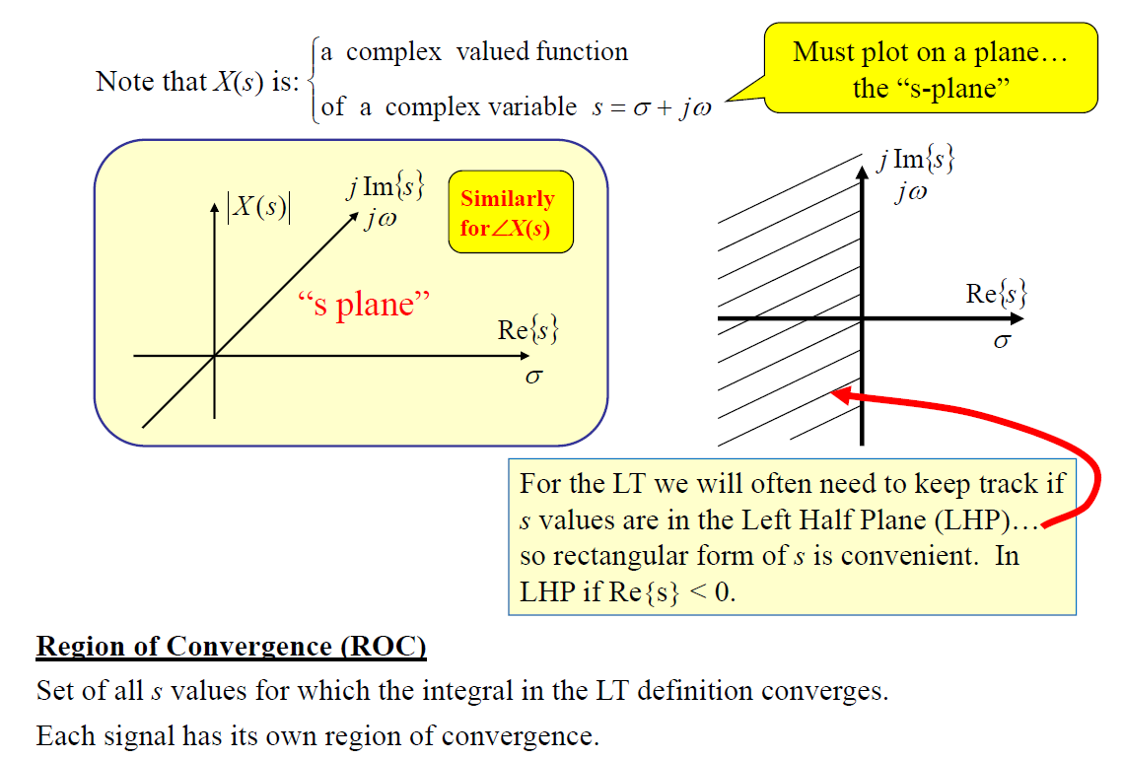
Laplace Transform Definition

Slide 14
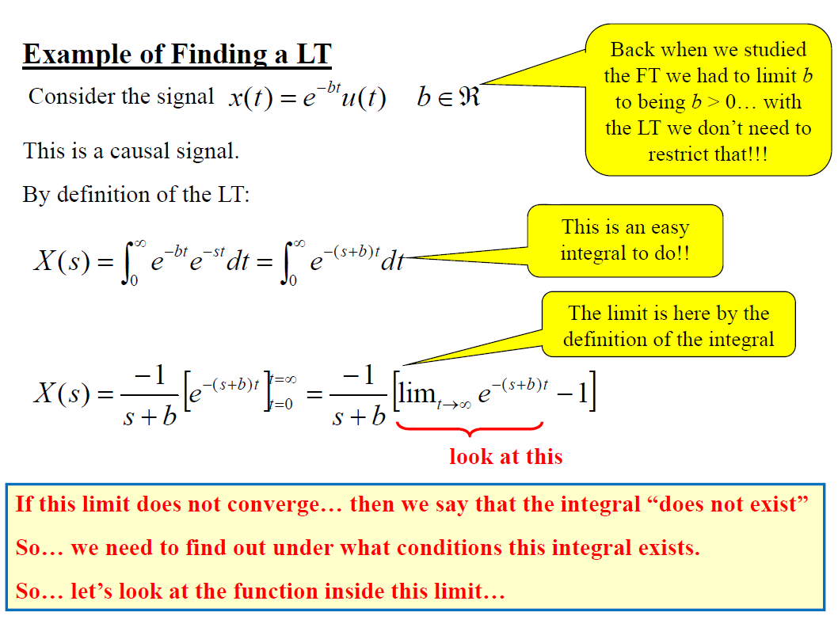
Laplace Transform Definition

Slide 15
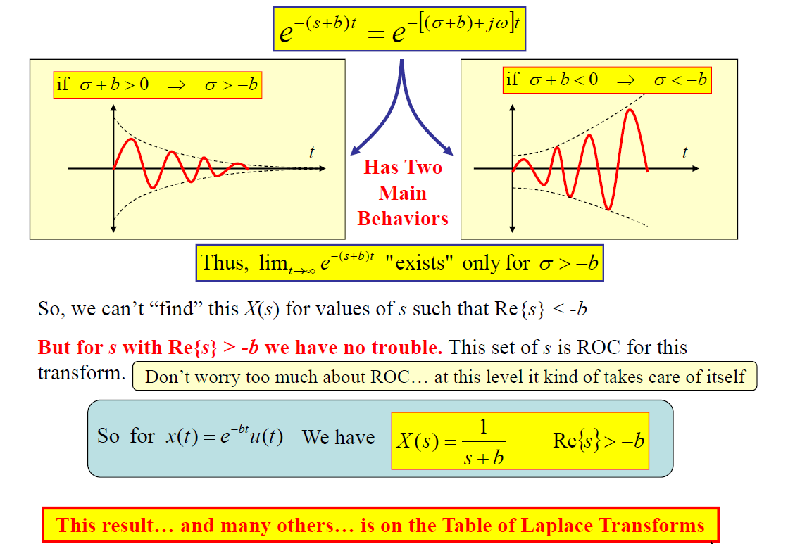
Laplace Transform Definition

Slide 16
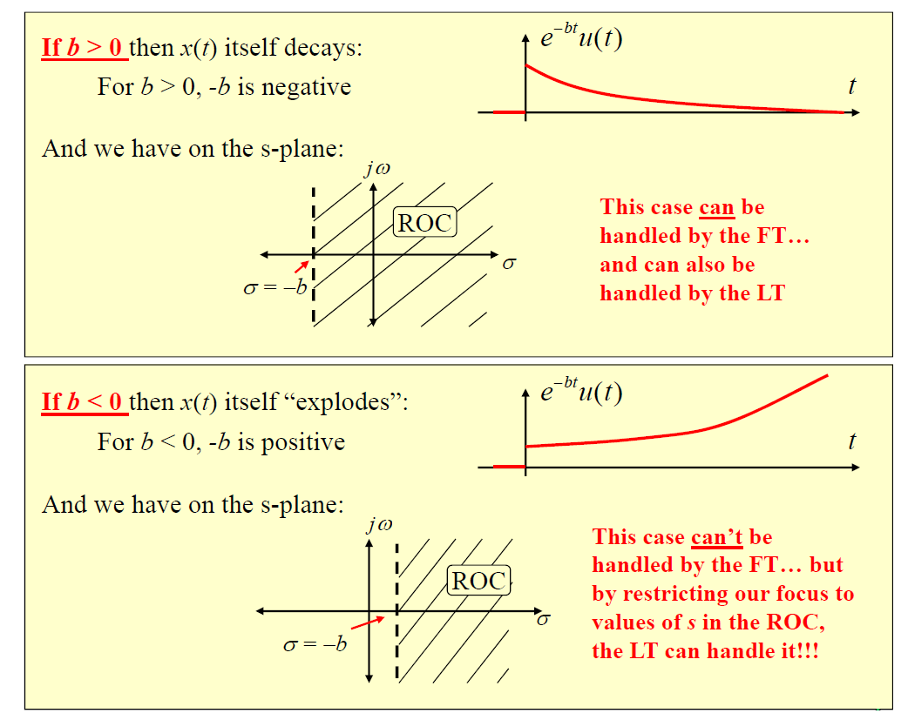
Laplace Transform Definition

Slide 17
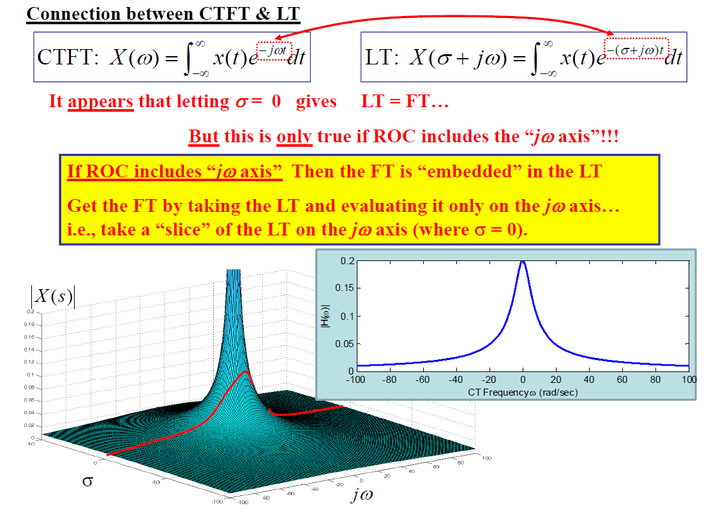
Laplace Transform Definition

Slide 18
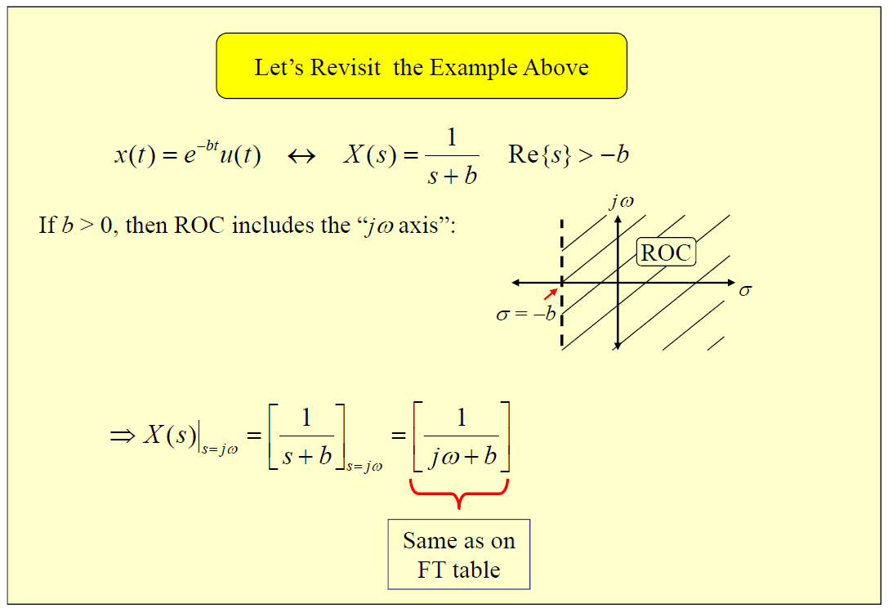
Laplace Transform Definition

Slide 19
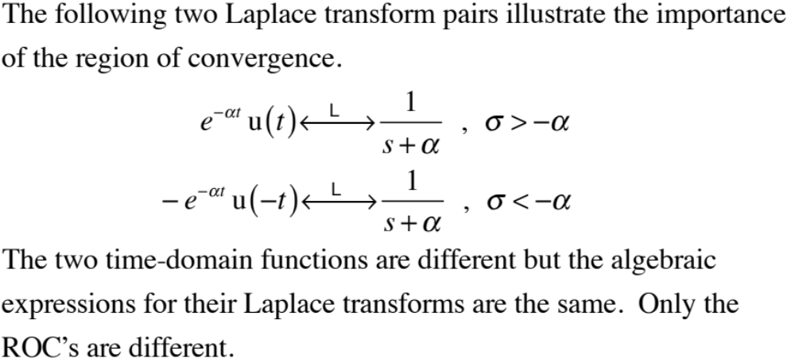
Region of Convergence
M. J. Roberts - All Rights Reserved. Edited by Dr. Robert Akl

Slide 20
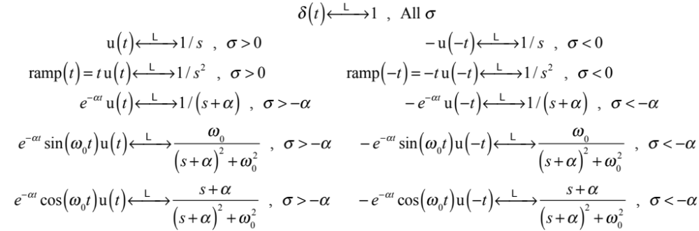
Region of Convergence
Some of the most common Laplace transform pairs
(There is more extensive table in the book.)
M. J. Roberts - All Rights Reserved. Edited by Dr. Robert Akl

Slide 21
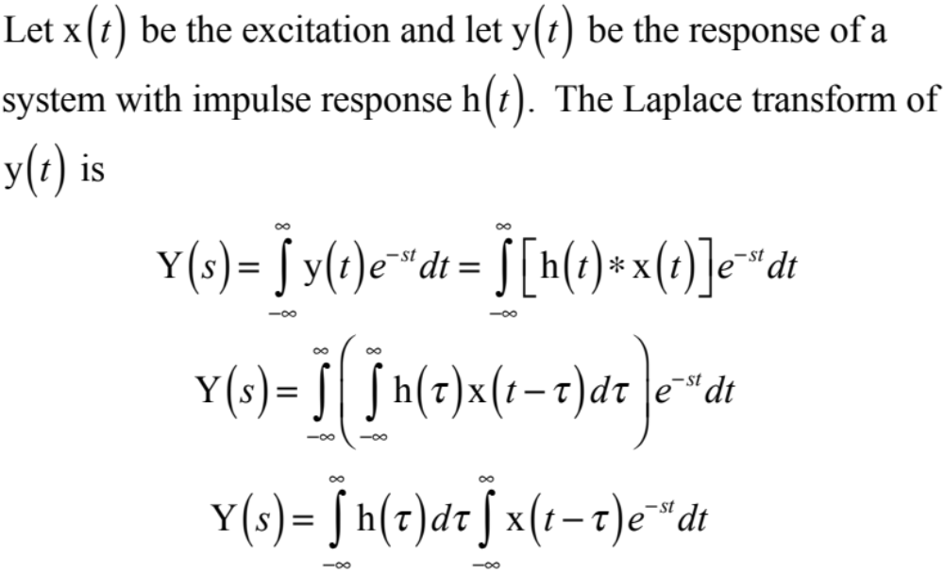
The Transfer Function
M. J. Roberts - All Rights Reserved. Edited by Dr. Robert Akl

Slide 22
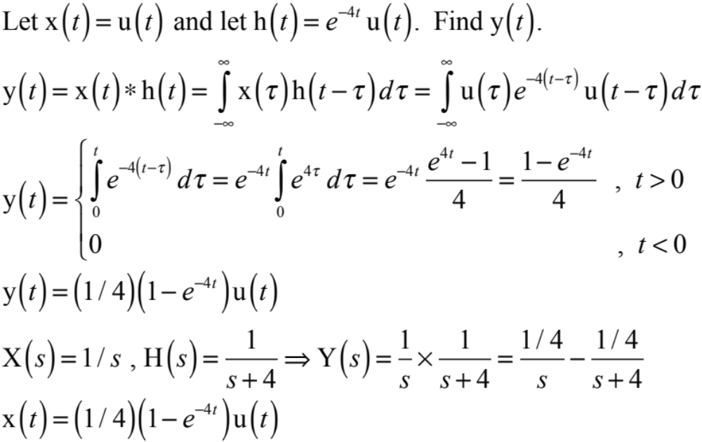
The Transfer Function
M. J. Roberts - All Rights Reserved. Edited by Dr. Robert Akl

Slide 23
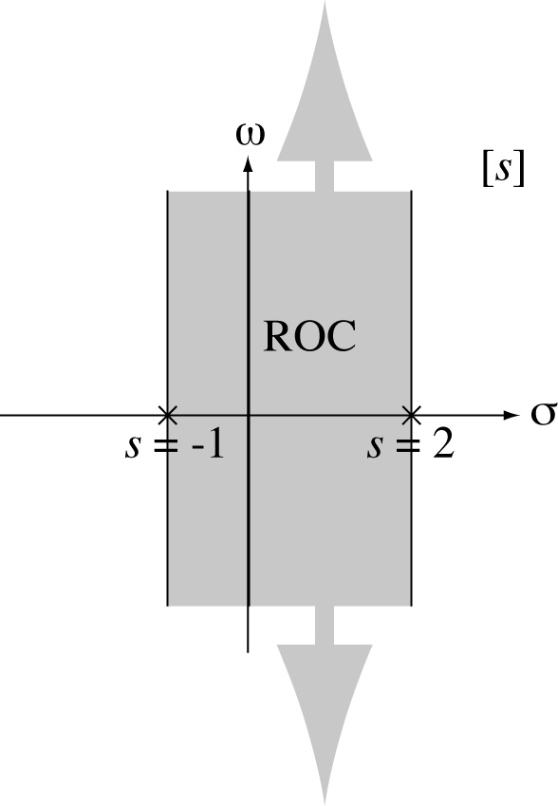
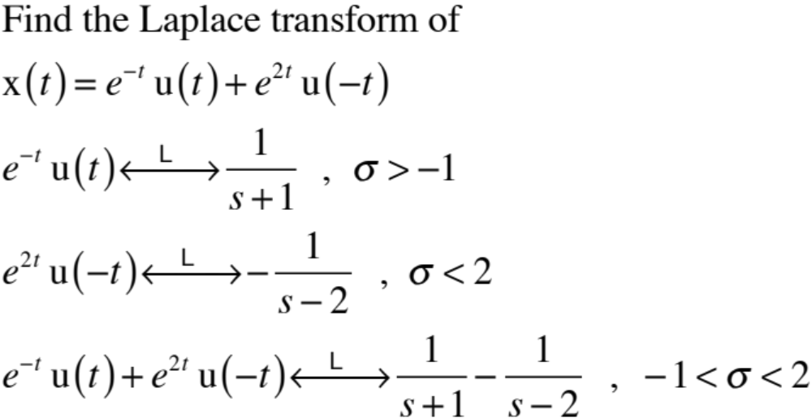
Laplace Transform Example
M. J. Roberts - All Rights Reserved. Edited by Dr. Robert Akl

Slide 24
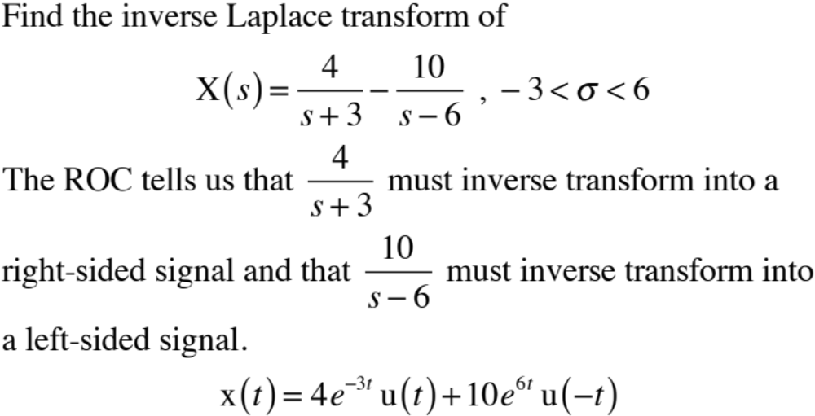
Laplace Transform Example
<number>z
M. J. Roberts - All Rights Reserved. Edited by Dr. Robert Akl

Slide 25
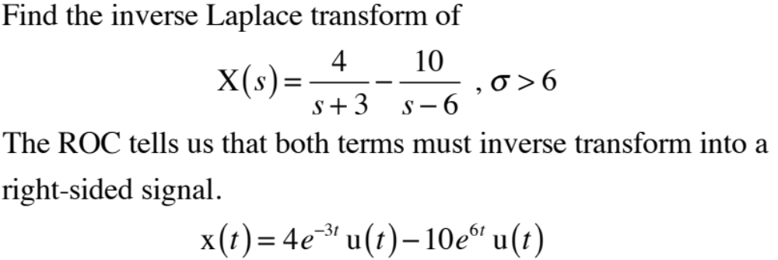
Laplace Transform Example
M. J. Roberts - All Rights Reserved. Edited by Dr. Robert Akl

Slide 26
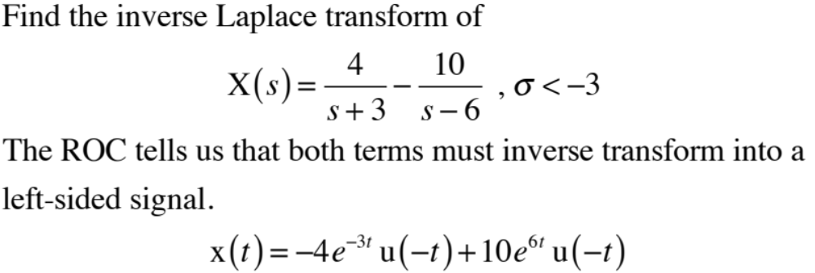
Laplace Transform Example
M. J. Roberts - All Rights Reserved. Edited by Dr. Robert Akl

Slide 27
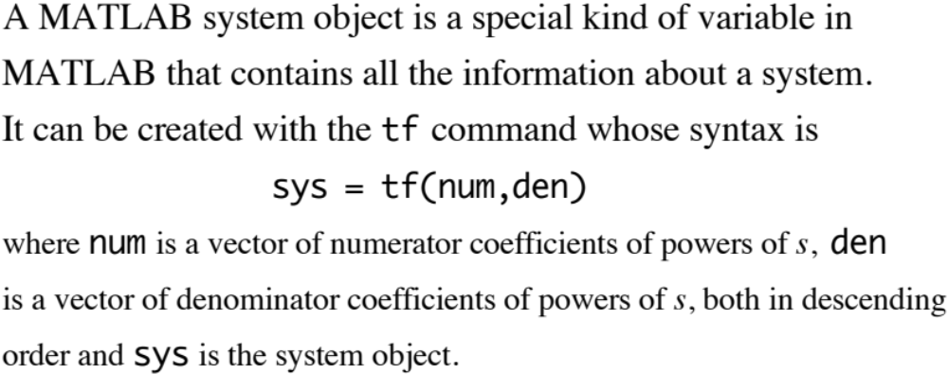
MATLAB System Objects
M. J. Roberts - All Rights Reserved. Edited by Dr. Robert Akl

Slide 28
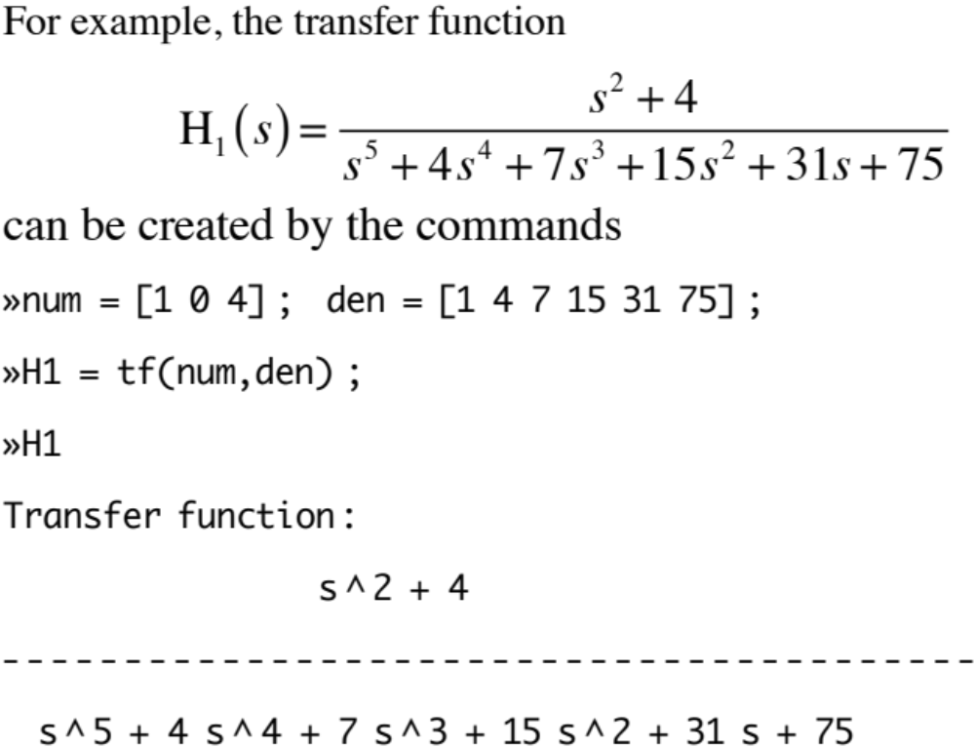
MATLAB System Objects
M. J. Roberts - All Rights Reserved. Edited by Dr. Robert Akl

Slide 29
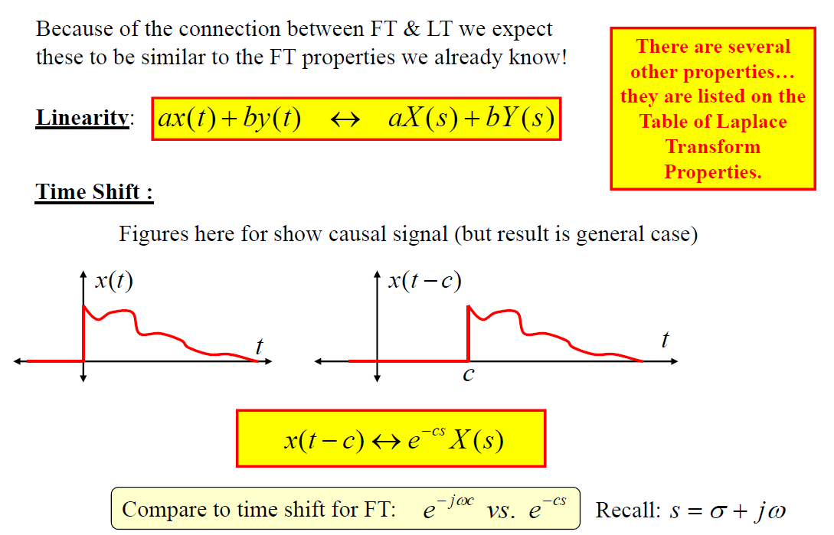
Properties of Bilateral Laplace Transform

Slide 30
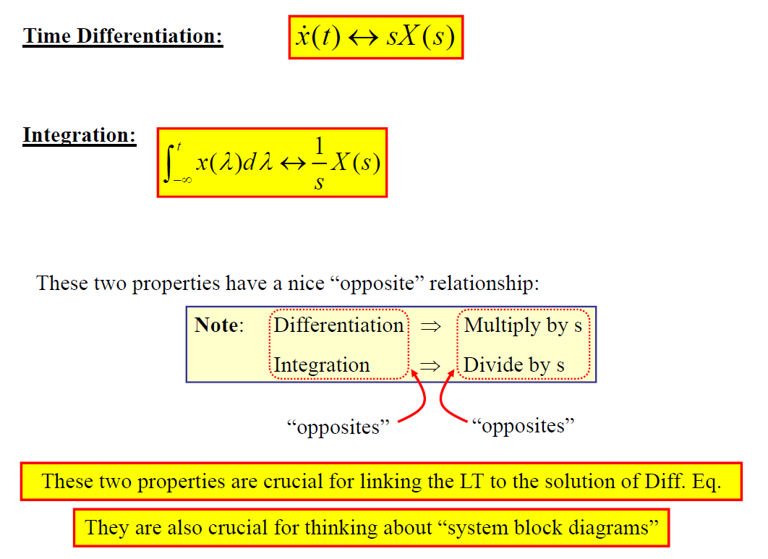
Properties of Bilateral Laplace Transform

Slide 31
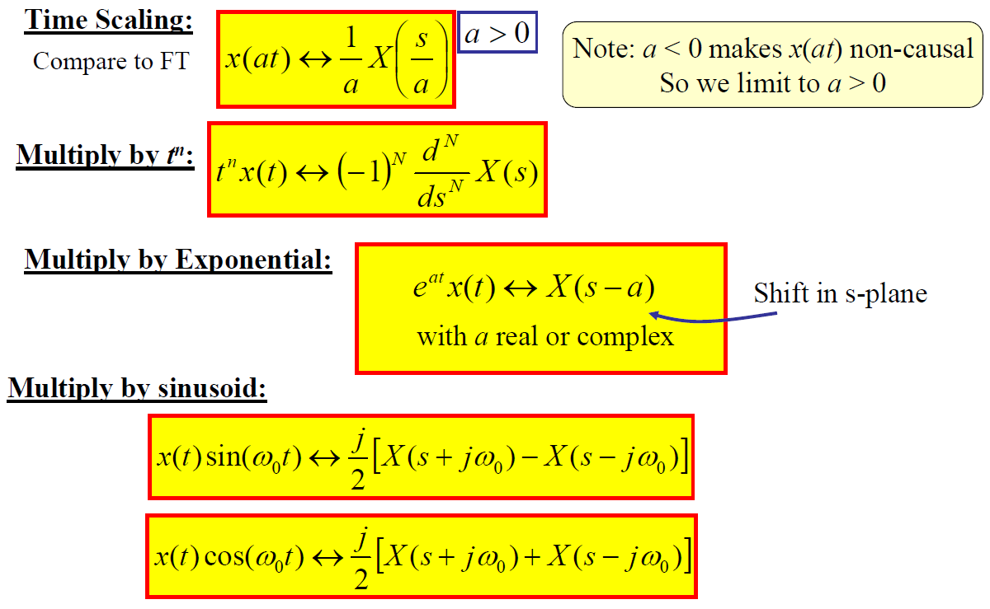
Properties of Bilateral Laplace Transform

Slide 32

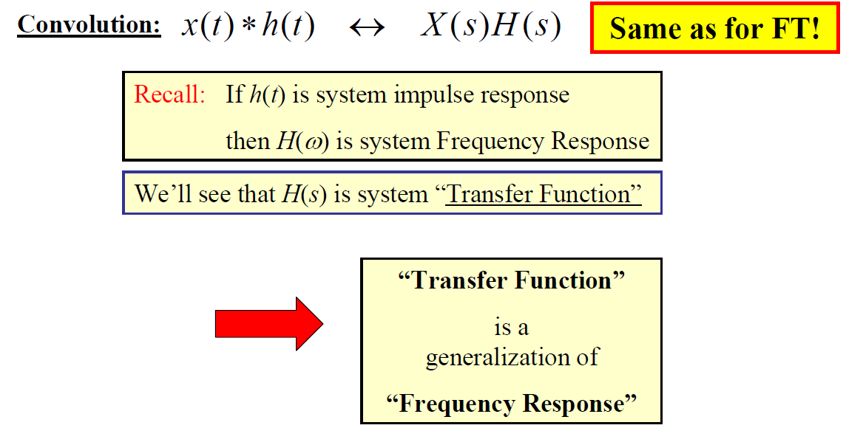
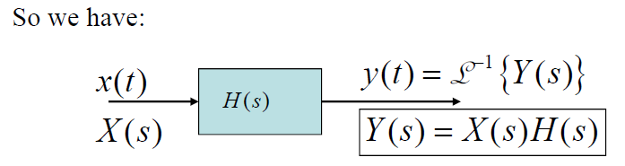
Properties of Bilateral Laplace Transform

Slide 33
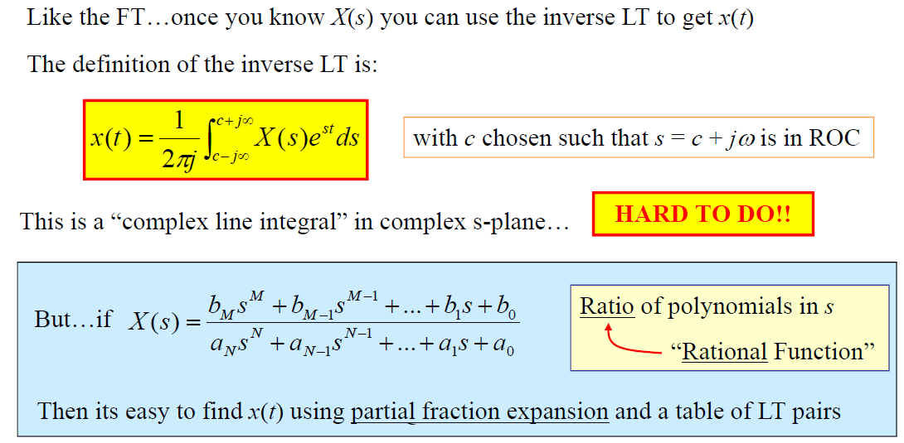
Inverse Laplace Transform

Slide 34
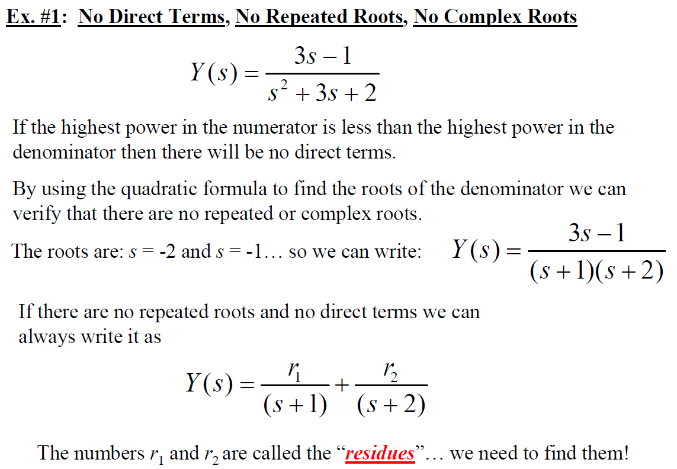

Slide 35
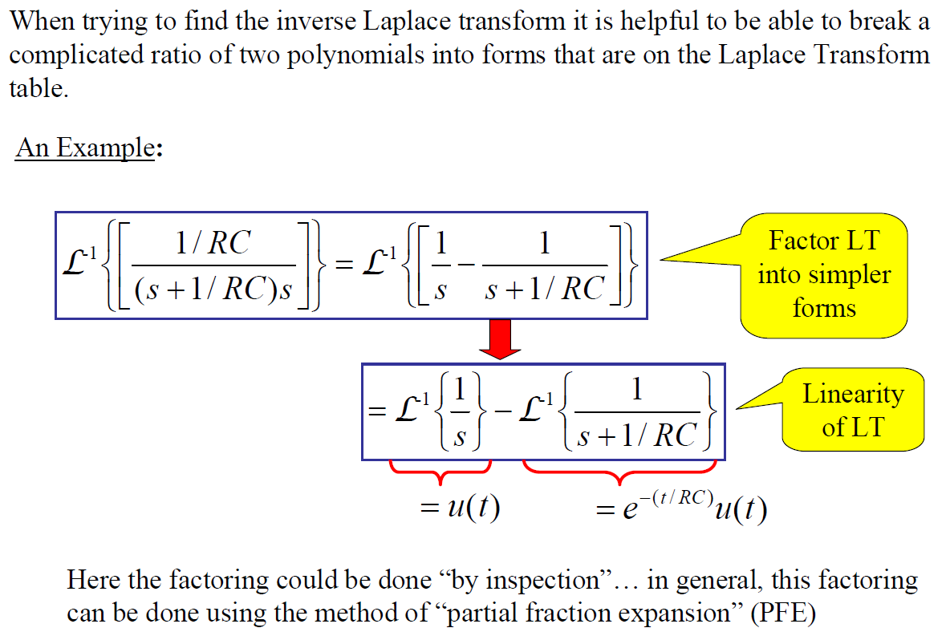
Partial Fractions

Slide 36
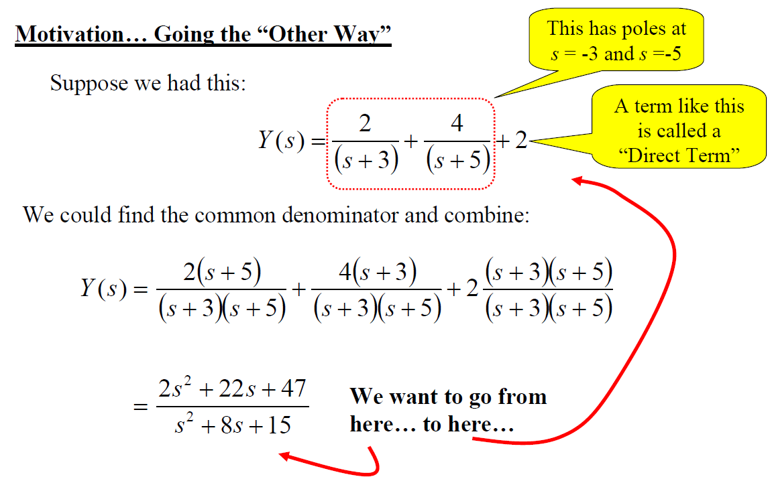
Partial Fractions

Slide 37
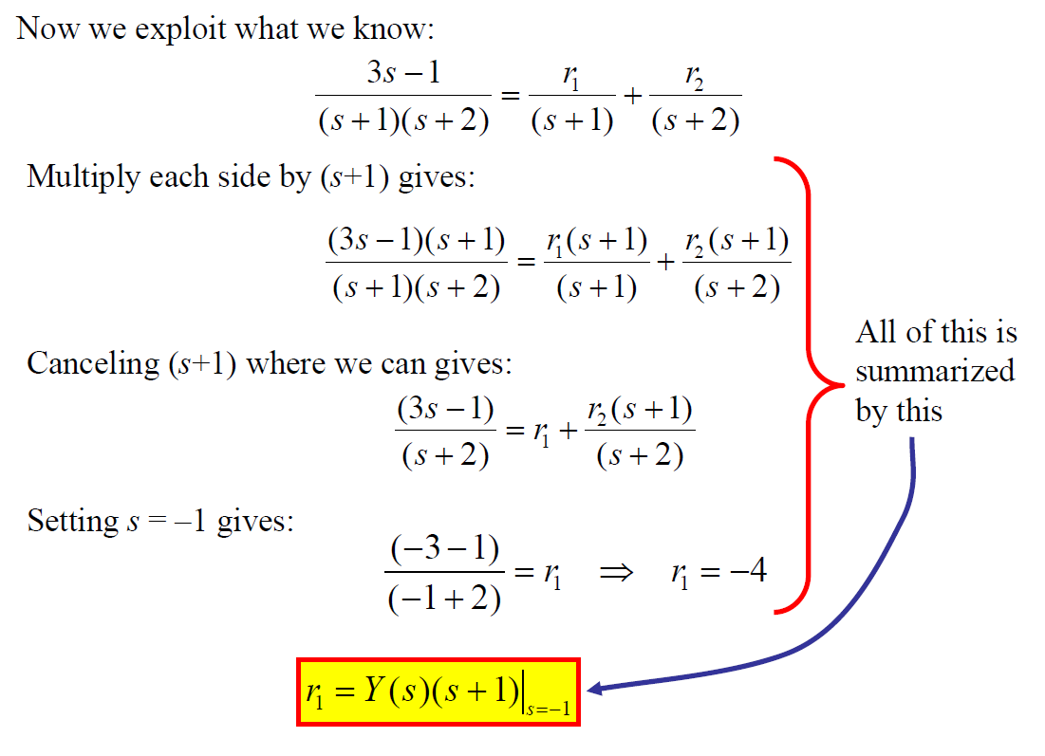

Slide 38
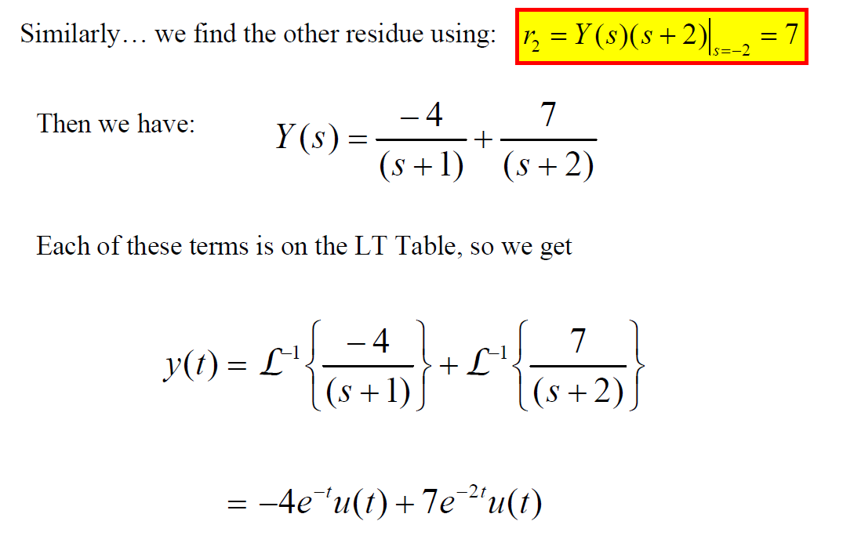

Slide 39
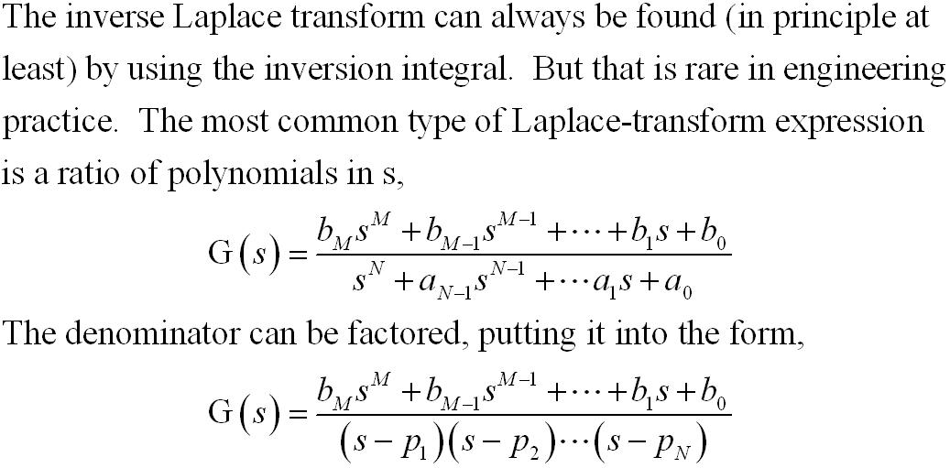
Partial-Fraction Expansion
M. J. Roberts - All Rights Reserved. Edited by Dr. Robert Akl

Slide 40
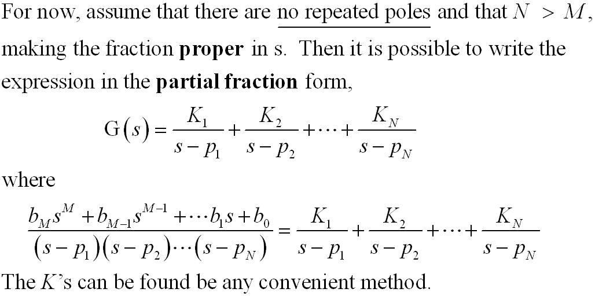
Partial-Fraction Expansion
M. J. Roberts - All Rights Reserved. Edited by Dr. Robert Akl

Slide 41
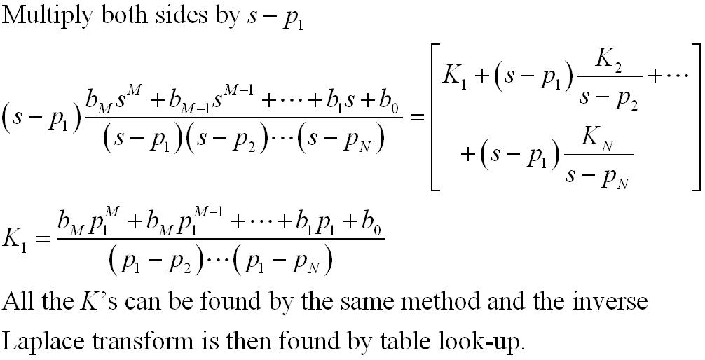
Partial-Fraction Expansion
M. J. Roberts - All Rights Reserved. Edited by Dr. Robert Akl

Slide 42
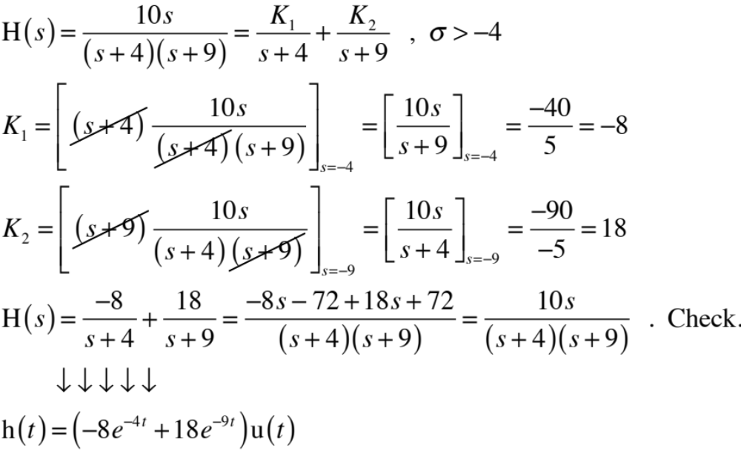
Partial-Fraction Expansion
M. J. Roberts - All Rights Reserved. Edited by Dr. Robert Akl

Slide 43
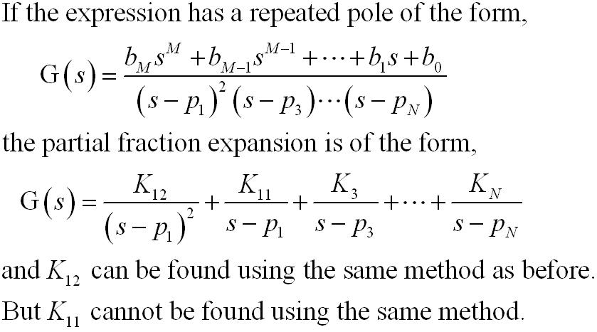
Partial-Fraction Expansion
M. J. Roberts - All Rights Reserved. Edited by Dr. Robert Akl

Slide 44
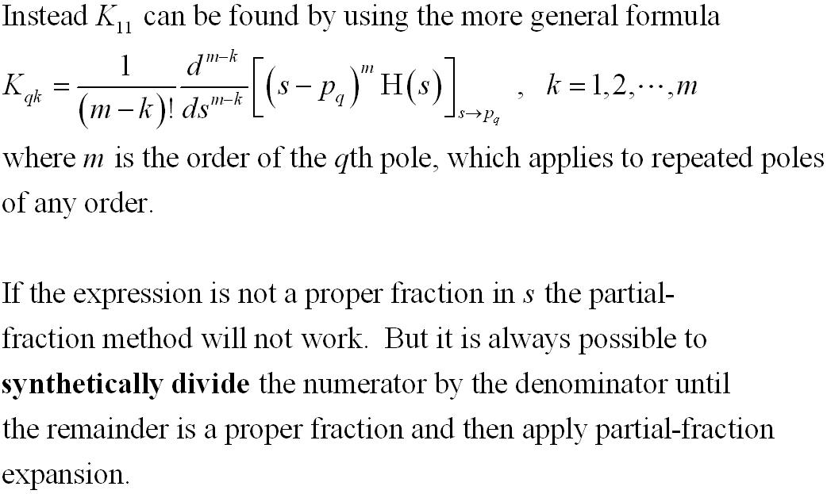
Partial-Fraction Expansion
M. J. Roberts - All Rights Reserved. Edited by Dr. Robert Akl

Slide 45
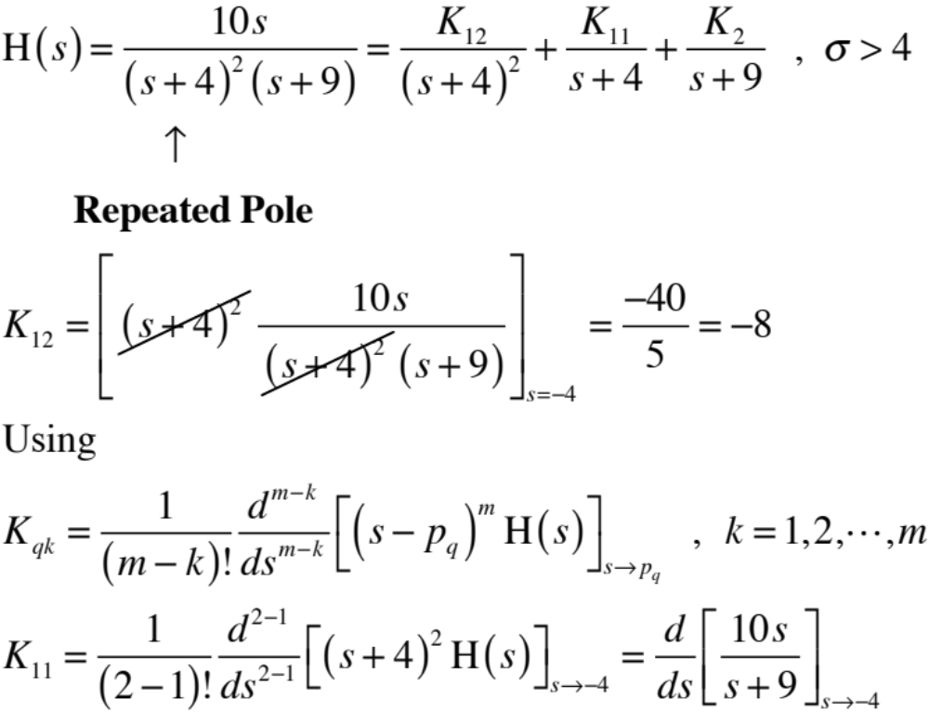
Partial-Fraction Expansion
M. J. Roberts - All Rights Reserved. Edited by Dr. Robert Akl

Slide 46
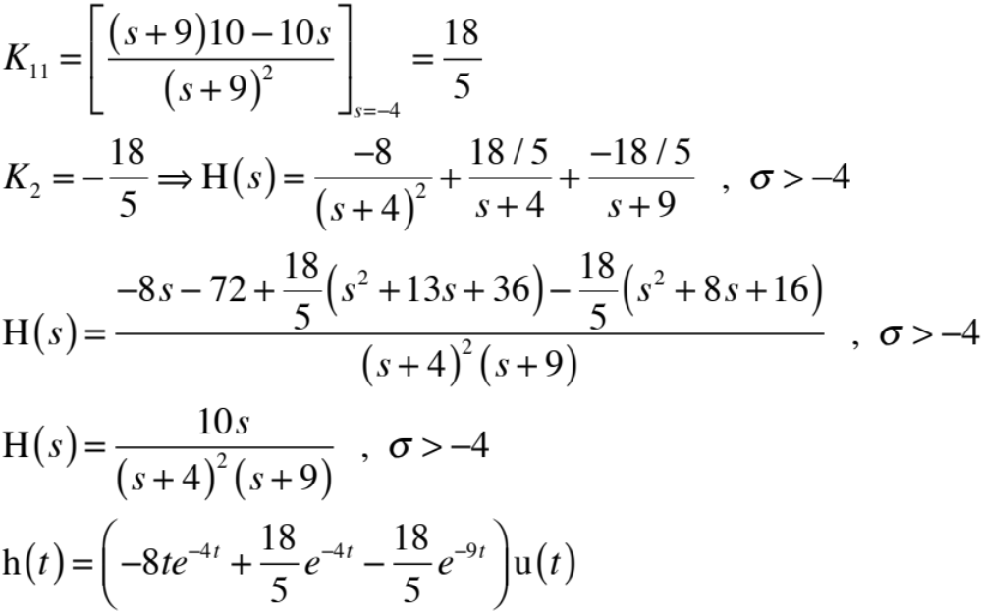
Partial-Fraction Expansion
M. J. Roberts - All Rights Reserved. Edited by Dr. Robert Akl

Slide 47
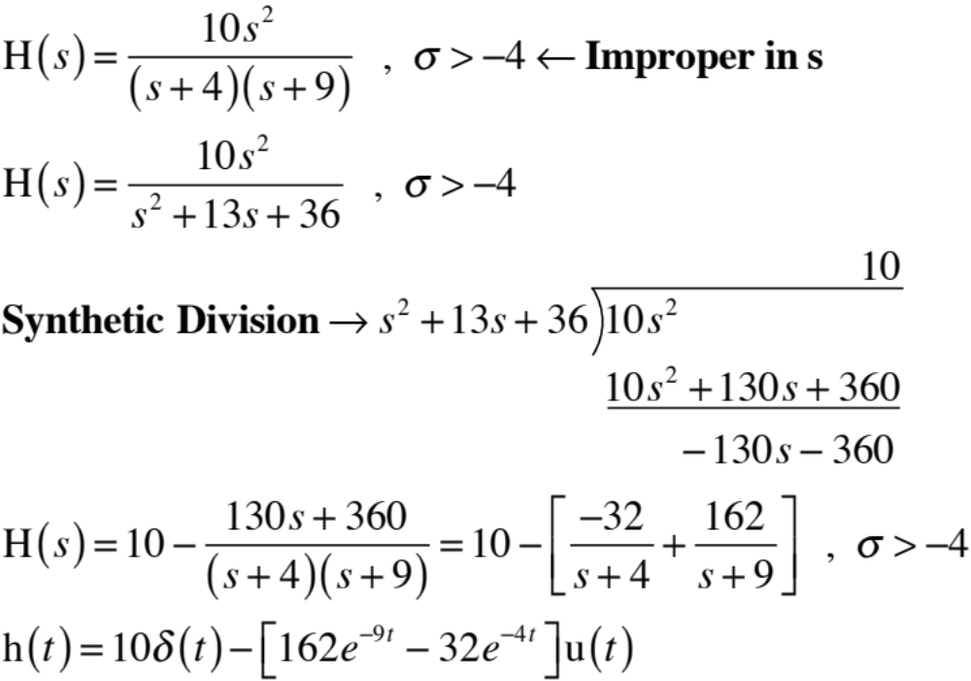
Partial-Fraction Expansion
M. J. Roberts - All Rights Reserved. Edited by Dr. Robert Akl

Slide 48
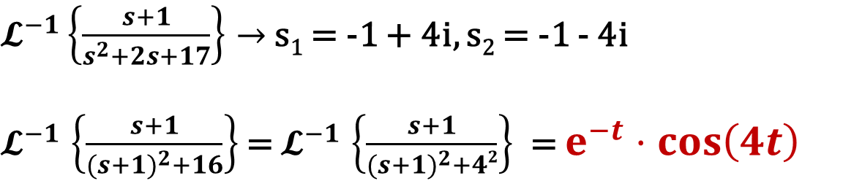


Partial-Fraction Expansion
Complex root situation

Slide 49


Inverse Laplace Transform Example
M. J. Roberts - All Rights Reserved. Edited by Dr. Robert Akl

Slide 50

Using LT to Solve Differential Equations

Slide 51


Slide 52


Slide 53


Slide 54


Slide 55


Slide 56


Slide 57


Slide 58


Slide 59


Slide 60


Slide 61


Slide 62


Slide 63


Slide 64



Slide 65

Poles and Zeros

Slide 66

Poles and Zeros

Slide 67

Poles and Zeros

Slide 68


Slide 69


Slide 70


Slide 71



Slide 72


